Slide 1
RAID UK & MALTA INSTRUCTOR CROSSOVER

Slide 2
Introduction
Welcome to YOUR RAID Instructor Crossover
Introductions
Presenter
Candidates
Purpose – to allow an active instructor in good standing from a recognised agency to teach RAID dive courses
Notes:
Stress – GOOD STANDING and RECOGNISED

Slide 3
Housekeeping
Please switch off phones
Toilet location
Emergency procedures
Breaks

Slide 4
Overview
The History of RAID
RAID Benefits
How the RAID system works
Course Structure
RAID differences
Doing business with RAID
Administration
How to run RAID programs
Standards Review
In water session – RAID unique water skills
Notes:
Mention SCHEDULING

Slide 5
The History of RAID
RAID was originally designed and launched by Poseidon
Unique system developed in 2007
In 2014 Jim Holliday and Paul Toomer form partnership with Barry Coleman
RAID relaunched worldwide
In 2018 RAID merges with Kalkomey USA
Notes:
Emphasise:
Been going for some time and complete already
Built by divers
Strong team behind the product
Proud of tec heritage

Slide 6
RAID Benefits
100% online training system
Member of the RSTC USA (Recreational Scuba Training Council)
Member of the RSTC Europe
ISO/EUF Certified
Founding member of the RTC (Rebreather Training Council)
Member of RESA (Rebreather Education Safety Association)
Conforms to HSE
Store based agency
Notes:
QUICK explanation to give an IDEA of the RAID process
Plus LIVE demonstration later

Slide 7
RAID Benefits
ONE Instructor membership
Fully online system
Dynamic quality control, increased liability protection
Smallest carbon ‘Fin print’ in the diving industry
No stock, no mistakes, never out of stock, no freight bills, no obsolete stock
New but familiar for crossover
Course material easily updated
An agency run by people who actually dive!
Notes:
Apart from ONLINE there are many HIDDEN SAVINGS you don’t notice with physical stock systems
EG’s:
Cost of returns
Cost of damage stock
Cost of being out of stock / turning down business
Cost of storage space
Cash flow considerations

Slide 8
How the RAID system works
Students register online
Students purchase course academics online or are credited by dive centre
Purchase covers online training and certification only
Practical is scheduled and charged by the dive store
Student selects a RAID store
Store assigns an Instructor to the student
Instructor monitors the student progress
Notes:
QUICK explanation to give an IDEA of the RAID process
More DETAIL and SCREENSHOTS in the “Admin” presentation
Plus LIVE demonstration later

Slide 9
How the RAID system works*
Students complete a series of quizzes
Exam opens when quizzes are done
Skills sign-off opens when exam is done
Instructor signs off confined and open water sessions
Student co-signs the skills confirming they were taught
Store does the final check & electronic sign off
Certification is electronic and immediate
* FREe-Learning is a new RAID initiative (see next slide)
Notes:
QUICK explanation to give an IDEA of the RAID process
More DETAIL and SCREENSHOTS in the “Admin” presentation
Plus LIVE demonstration later

Slide 10
How FREe-Learning works*
The complete academic library is open for browsing
“Students” register if they do not already have a profile
Associate themselves with a RAID DC
DC can communicate with “student”
”Student” must pay for training to certify
Program is a proactive initiative in tough times BUT will remain in place after COVID-19
Notes:
QUICK explanation to give an IDEA of the RAID process
More DETAIL and SCREENSHOTS in the “Admin” presentation
Plus LIVE demonstration later

Slide 11
REMOTe-Learning
Certain RAID programs can be completed (certificate issued and course preparation) while ‘social distancing.’
Student can complete academics and work with an instructor via A/V tools (Ring Central, Zoom, etc.)
Nitrox standards adjusted to allow use of on-line virtual oxygen analyser (app powered by RAID)
Current courses available includes: Equipment, Eco, Nitrox, Core rebreather knowledge
Notes:
QUICK explanation to give an IDEA of the RAID process
More DETAIL and SCREENSHOTS in the “Admin” presentation
Plus LIVE demonstration later

Slide 12
Course Structure
Linear system or menu driven?
Both systems have advantages
RAID uses the best of both
The benefit to students is choice… ConEd at their pace and their preferences
Notes:
Explain – RAID the only agency to run a full system of RB training

Slide 13
Course Structure
Open Water
Advanced
Rescue
Divemaster
Specialties
Dive Pro
Linear Training System
Notes:
Ask students for an example of this system
PADI

Slide 14
Course Structure
Specialties
Menu Training System
Specialties
Open Water
Divemaster
Dive Pro
Specialties
Advanced
Rescue
Notes:
Ask students for an example of this system
SSI

Slide 15
Course Structure
Open Circuit Flowchart
All OC courses
Recreational
Technical
Depicts flow
Demonstrates standards
Notes:
Explain that it does not really matter what the gear configuration is as long as it meets standards
All training can be done on OC or CCR

Slide 16
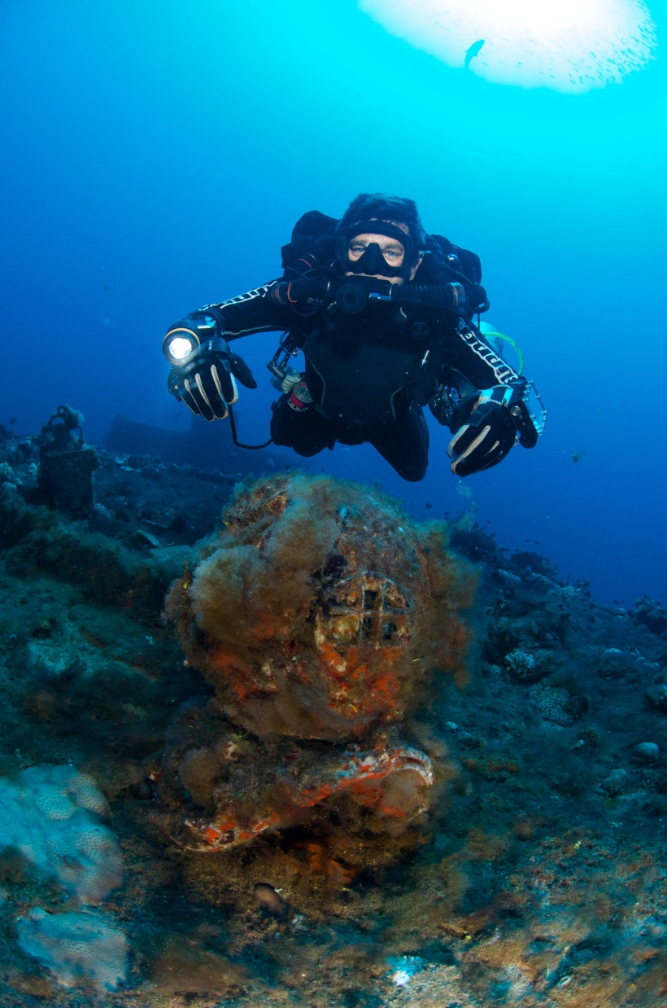
Course Structure
Other RAID Programs
Technical Open Circuit
Recreational and technical CCR
Cave
Sidemount
Wreck
Freedive
Notes:
Brief overview of tec programs
Mention that separate tec crossover can be done

Slide 17
Course Structure
Crossover Levels
Crossing from other agency diver levels
RAID recognises and ISO/EUF or RSTC approved agency as an equivalent, unless that agency does not require an independent instructor exam.
Notes:
Can use standards to explain these examples

Slide 18
Course Structure
IDP and ITP
Theory program
Developed for all disciplines
Practical separate
Confined
OW
Core
Rec CCR
Practical
Rec OC
Practical
Tec Practical
Notes:
The IT courses will be big events for RAID.
All disciplines can attend the same program for the theory and academic sections
Water skills done with Training Directors for different disciplines
E.G. A freedive IT candidate can attend the program with everyone and then do the water skill section with the Freedive Training Director

Slide 19
RAID Differences
Skills
Certain skills have been made more efficient
Neutral buoyancy
RAID leads the market: neutral buoyancy from the start
SAC rates
Calculated from Open Water 20 diver level
Trimix
Available on recreational programs

Slide 20
Doing business with RAID
Your local office manager (RRO) provides:
Pricelists
Up to date info
Access to credits
Access to further training
Business advice when needed

Slide 21
Administration
Dive Centre registers with RAID (With Local Raid Regional Office (RRO))
DC invites RAID instructor to join Dive Centre staff
My training tools/ manage my team/ add pro member/instructor email/ instructor enters password/assign
Student registers online and then registers with chosen Dive Centre OR Student visits DC and DC registers student online where student auto allocates

Slide 22
Administration
Dive Centre allocates Instructor to Student
Student completes all quizzes and exams
Instructor and student complete and sign off all confined and open water
Instructor notifies Dive Centre of course completion
Dive Centre certifies student

Slide 23
Administration
RAID website
Registration
Purchasing Courses
Student Progress
Skill sign offs
Final sign off & certification
Go to:
RAID website for:
Student login area
Instructor login area
Store login area
Notes:
Use Internet and go to live site.
If no internet click the link to the RAID admin ppt

Slide 24
How to run RAID programs
All forms are completed online and retained on RAID server
Medical
Liability Release
Safe Diving Practices
Forms presently collect by store
Medicals if required (upload during certification process)
Offline Quick Quiz for many courses are in “My Documents”

Slide 25
How to run RAID programs
Instructor assigned by the store
Check in “My Students” & follow progress online
Review exam results
Review questions students missed during practice
No need for formal lectures
Run practical skills sessions in confined water
Sign off skills at the end of confined water session
Students to co-sign skills
Notes:
This is a step by step explanation.
Can use live students to demonstrate if you have internet

Slide 26
How to run RAID programs
Dive Site Evaluation Checklist for each new site
Students all sign that they agree
Scan and file at the store
Risk management filed for each dive area
Run practical open water dives
Sign off skills after the open water dives
Students to co-sign skills and complete online log
Inform dive store when complete
Notes:
Show candidates forms online
Explain the liability coverage using the “Dive site evaluation checklist”
Explain that the students are essentially agreeing with the Instructor and learning how to do the evaluation.

Slide 27
How to run RAID programs
Dive Store to complete final sign off
Check if medical has been submitted or not required
Student member signed off
Instructor signed off
Quick Quiz scanned on file (where necessary)
Student member has completed dive log (this is required!)
Photo is on file
E-card emailed automatically to student
C-card can be requested
Notes:
Show final sign off page if not already done.

Slide 28
How to run RAID programs
Where do we find Confined Water Instructor guide?
Where do we find Open Water Instructor guide?
What dives are covered by them?
Open Water 20
Explorer 30
Advanced 35
Master Rescue
Notes:
Confined water Inst guide found under “Confined water” manual in Instructor course.
Open water Inst guide found under “Open water” manual in Instructor course.
Explorer 30 look in Explorer 30 student open water manual
Advanced 35 look in Open Water Inst guide or student Open water manual
Master Rescue look in Open Water Inst guide or student Open water manual

Slide 29
Standards Review
General Standards
Definitions
Equipment
Ratios
Referrals
Notes:
Use the standard manual to look through and find these items.
May be good to have a manual available
First point in slide links to standards document

Slide 30
Standards Review
Admin Procedures
Waivers
Membership
Store levels
Member status
Risk Management
Notes:
Continue to use the standards book

Slide 31
Standards Review
Try Dives
Core levels
Open Water 20
Advanced 35
Specialties
Master Rescue
Divemaster
Notes:
Continue to use the standards book

Slide 32
Standards Review
Professional Levels
Open Circuit Instructor
Sport Rebreather Instructor
Specialty Instructor
Open Circuit Instructor Trainer
Rebreather Instructor Trainer
Specialty Instructor Trainer
RAID Examiner
Notes:
Continue to use the standards book

Slide 33
In Water Session
Orientation to the RAID system
Explanation of RAID key skills
Highlighting skills RAID does differently
Showing the evolution from tec
Lets go have some fun.
Notes:
Some skills taught with no fins
Weighting no fins – exhaling head up
Equipment
With equipment – no fins
Positive / neg entry
Feet first descent
Trim
Primary donate
Reg recovery
Snorkel
S drill
SMB surface

Slide 34
In Summary
You now have an overview of the RAID system
You will learn more as you start to train with the system
We are here to assist whenever you need us

Slide 35
Thank You
Any Questions

