Slide 1
Divemaster Crossover

Slide 2
Introduction
Welcome to YOUR RAID Divemaster Crossover
Introductions
Presenter
Candidates
Purpose – to allow an active divemaster in good standing from a recognised agency to assist RAID dive courses & teach try dives
Notes:
Stress – GOOD STANDING and RECOGNISED

Slide 3
Housekeeping
Please switch off phones
Toilet location
Emergency procedures
Breaks

Slide 4
Overview
The History of RAID
RAID Benefits
How the RAID system works
Course Structure
RAID differences
Doing business with RAID
Administration
How to run RAID programs
Standards Review
In water session – RAID unique water skills
Notes:
Mention SCHEDULING

Slide 5
The History of RAID
RAID was originally designed and launched by Poseidon
Unique system developed in 2007
In 2014 Jim Holliday and Paul Toomer form partnership with Barry Coleman
RAID relaunched worldwide
In 2018 RAID merges with Kalkomey USA
Notes:
Emphasise:
Been going for some time and complete already
Built by divers
Strong team behind the product
Proud of tec heritage

Slide 6
RAID Benefits
100% online training system
Member of the RSTC USA (Recreational Scuba Training Council)
ISO/EUF Certified
Founding member of the RTC (Rebreather Training Council)
Conforms to HSE
Store based agency
Notes:
QUICK explanation to give an IDEA of the RAID process
Plus LIVE demonstration later

Slide 7
RAID Benefits
ONE Instructor membership
Fully online system
Dynamic quality control, increased liability protection
Smallest carbon ‘Fin print” in the diving industry
No stock, no mistakes, never out of stock, no freight bills, no obsolete stock
New but familiar for crossover
Course material easily updated
An agency run by people who actually dive!
Notes:
Apart from ONLINE there are many HIDDEN SAVINGS you don’t notice with physical stock systems
EG’s:
Cost of returns
Cost of damage stock
Cost of being out of stock / turning down business
Cost of storage space
Cash flow considerations

Slide 8
How the RAID system works
Students register online
Students purchase course academics online or are credited by dive centre
Purchase covers online training and certification only
Practical is scheduled and charged by the dive store
Student selects a RAID store
Store assigns an Instructor to the student
Instructor monitors the student progress
Notes:
QUICK explanation to give an IDEA of the RAID process
More DETAIL and SCREENSHOTS in the “Admin” presentation
Plus LIVE demonstration later

Slide 9
How the RAID system works
Students complete a series of quizzes
Exam opens when quizzes are done
Skills sign off opens when exam is done
Instructor signs off confined and open water sessions
Student co signs the skills confirming they were taught
Store does the final check & electronic sign off
Certification is electronic and immediate
Notes:
QUICK explanation to give an IDEA of the RAID process
More DETAIL and SCREENSHOTS in the “Admin” presentation
Plus LIVE demonstration later

Slide 10
Course Structure
Linear system or menu driven?
Both systems have advantages
RAID uses the best of both
Notes:
Explain – RAID the only agency to run a full system of RB training

Slide 11
Course Structure
Open Water
Advanced
Rescue
Divemaster
Specialties
Dive Pro
Linear Training System
Notes:
Ask students for an example of this system
PADI

Slide 12
Course Structure
Specialties
Menu Training System
Specialties
Open Water
Divemaster
Dive Pro
Specialties
Advanced
Rescue
Notes:
Ask students for an example of this system
SSI

Slide 13
Course Structure
Open Circuit Flowchart
All OC courses
Recreational
Technical
Depicts flow
Demonstrates standards
Notes:
Explain that it does not really matter what the gear configuration is as long as it meets standards
All training can be done on OC or CCR

Slide 14
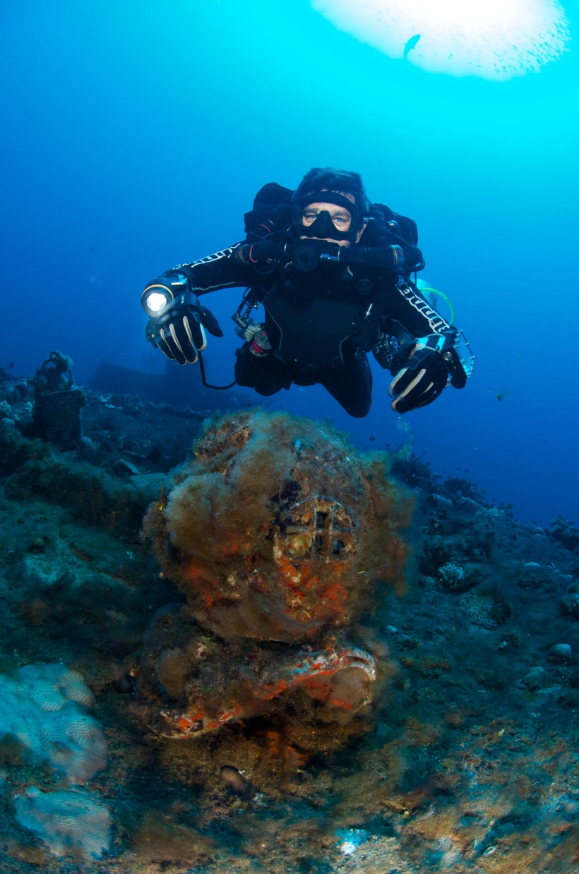
Course Structure
Other RAID Programs
Technical Open Circuit
Recreational and technical CCR
Cave
Sidemount
Wreck
Freedive
Notes:
Brief overview of tec programs
Mention that separate tec crossover can be done

Slide 15
Course Structure
Crossover Levels
Crossing from other agency diver levels
RAID recognises and ISO/EUF or RSTC approved agency as an equivalent, unless that agency does not require an independent instructor exam.
Notes:
Can use standards to explain these examples

Slide 16
RAID Differences
Skills
Certain skills have been honed to make them more efficient
Neutral buoyancy
RAID leads the market in neutral buoyancy education
SAC rates
Calculated from Open Water 20 diver level
Trimix
Available even on recreational programs

Slide 17
Doing business with RAID
Your local office manager will provide:
Pricelists
Up to date info
Access to credits
Access to further training
Business advice when needed

Slide 18
How to run RAID programs
All forms are completed online and retained on RAID server
Medical
Liability Release
Safe Diving Practices
Forms presently collect by store
Medicals if required (upload during certification process)
Offline Quick Quiz
These are in “My Documents”

Slide 19
How to run RAID programs
Instructor assigned by the store
Check in “My Students” & follow progress online
Review exam results
Review questions students missed during practice
No need for formal lectures
Run practical skills sessions in confined water
Sign off skills at the end of confined water session
Students to co-sign skills
Notes:
This is a step by step explanation.
Can use live students to demonstrate if you have internet

Slide 20
How to run RAID programs
Dive Site Evaluation Checklist for each new site
Students all sign that they agree
Scan and file at the store
Risk management filed for each dive area
Run practical open water dives
Sign off skills after the open water dives
Students to co-sign skills and complete online log
Inform dive store when complete
Notes:
Show candidates forms online
Explain the liability coverage using the “Dive site evaluation checklist”
Explain that the students are essentially agreeing with the Instructor and learning how to do the evaluation.

Slide 21
How to run RAID programs
Dive Store to complete final sign off
Check if medical has been submitted or not required
Student member signed off
Instructor signed off
Quick Quiz scanned on file
Student member has completed dive log
Photo is on file
E-card emailed automatically to student
C- card can be requested
Notes:
Show final sign off page if not already done.

Slide 22
How to run RAID programs
Where do we find Confined Water Instructor guide?
Where do we find Open Water Instructor guide?
What dives are in?:
Open Water 20
Explorer 30
Advanced 35
Master Rescue
Notes:
Confined water Inst guide found under “Confined water” manual in Instructor course.
Open water Inst guide found under “Open water” manual in Instructor course.
Explorer 30 look in Explorer 30 student open water manual
Advanced 35 look in Open Water Inst guide or student Open water manual
Master Rescue look in Open Water Inst guide or student Open water manual

Slide 23
In Water Session
Orientation to the RAID system
Explanation of RAID key skills
Highlighting skills RAID does differently
Showing the evolution from tec
Lets go have some fun.
Notes:
Some skills taught with no fins
Weighting no fins – exhaling head up
Equipment
With equipment – no fins
Positive / neg entry
Feet first descent
Trim
Primary donate
Reg recovery
Snorkel
S drill
SMB surface

Slide 24
In Summary
You now have an overview of the RAID system
You will learn more as you start to train with the system
We are here to assist whenever you need us

Slide 25
Thank You
Any Questions

